Slide 1
Chicago Neighborhoods -Retail Business - Data Analytics

Slide 2
Content
Business Case – Analysis of the neighborhoods in Chicago, IL for a retail business prospective
Data Acquisition – Wikipedia ( Chicago neighborhoods); Foursquare API (Chicago neighborhood venues), Geocoder library (longitude and latitude)
Data Preparation – Pandas(converting xml data into panda dataframe)
Data Visualization – Folium library (neighborhoods and clusters maps), matplotlib library (cluster bar graphs)

Slide 3
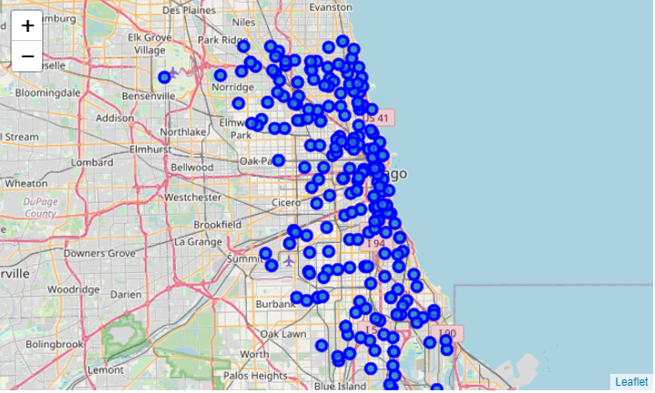
Chicago Neighborhoods – Folium Library

Slide 4
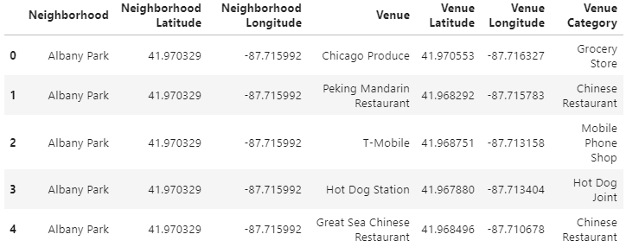
Chicago Neighborhood Segmentation – Foursquare API
A list of 5 venues of the Albany Park neighborhood

Slide 5
Chicago Neighborhood Segmentation – Foursquare API
Foursquare API results:
Limit: 100 venues
Radius: 500 m
Number of Unique Venues Returned: 347

Slide 6
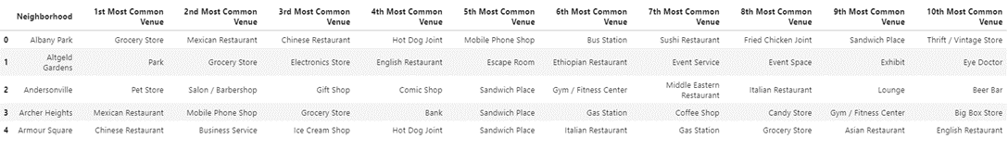
Chicago Neighborhood Segmentation – Foursquare API
A list of 5 neighborhoods with their 10 most common venues

Slide 7
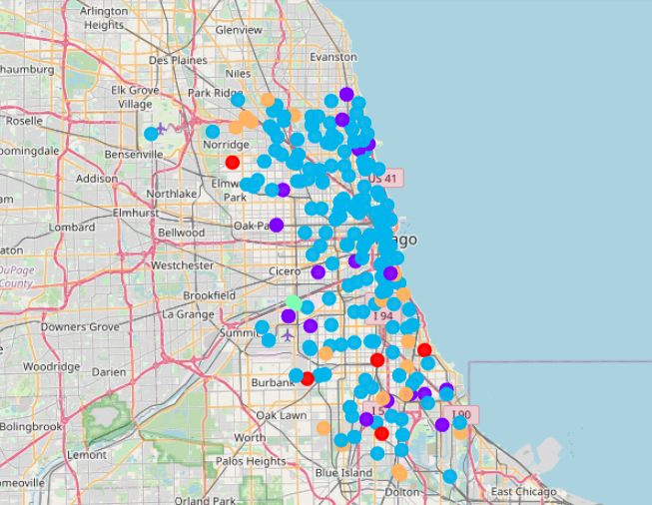
K-means ML Clustering
K-means Machine Learning Algorithm used to segment data in 5 clusters

Slide 8
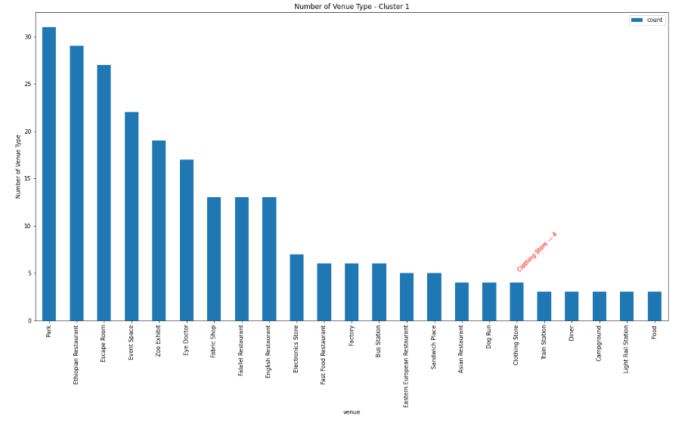
Cluster 1 (containing 4 clothing stores)

Slide 9
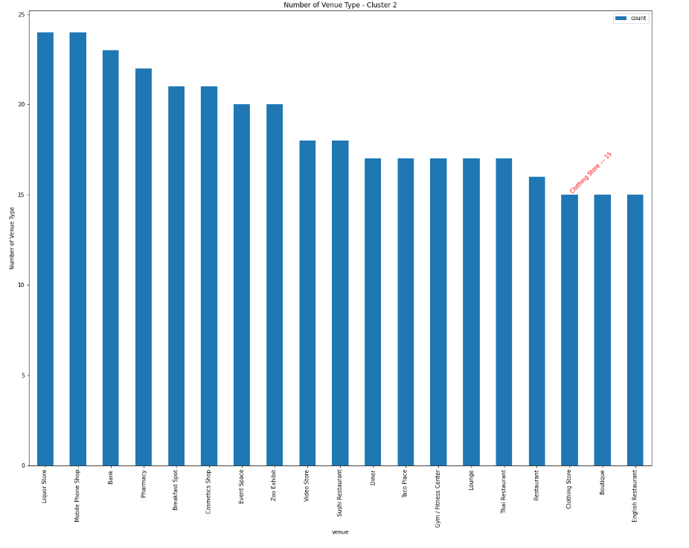
Cluster 2 (containing 15 clothing stores)

Slide 10
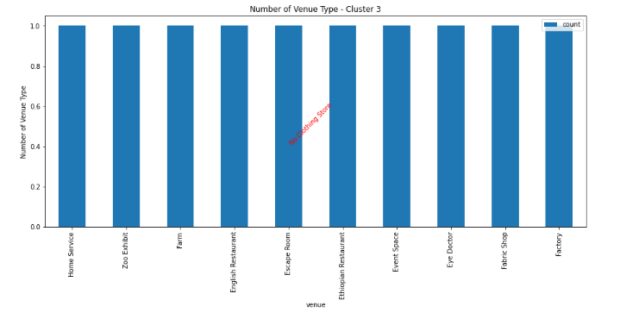
Cluster 3 (containing 0 clothing stores)

Slide 11
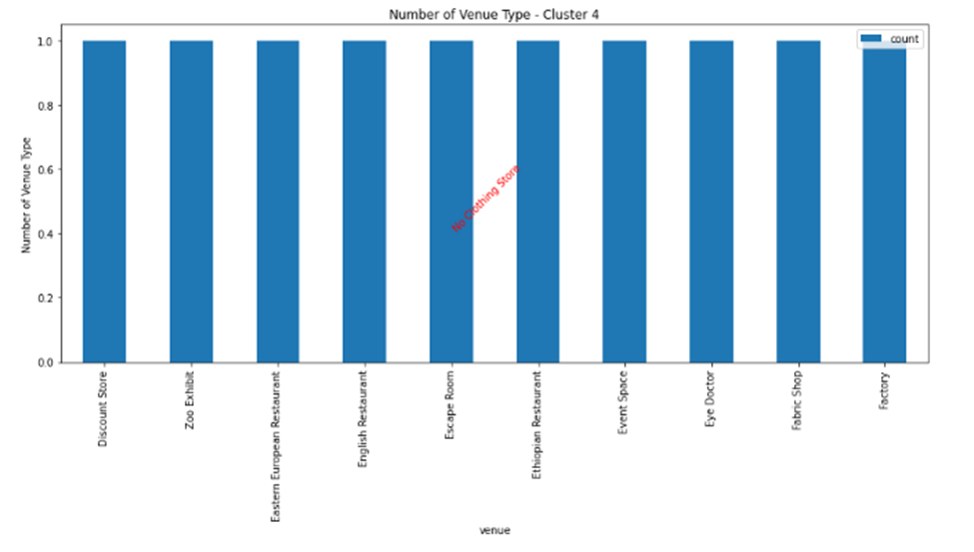
Cluster 4 (containing 0 clothing stores)

Slide 12
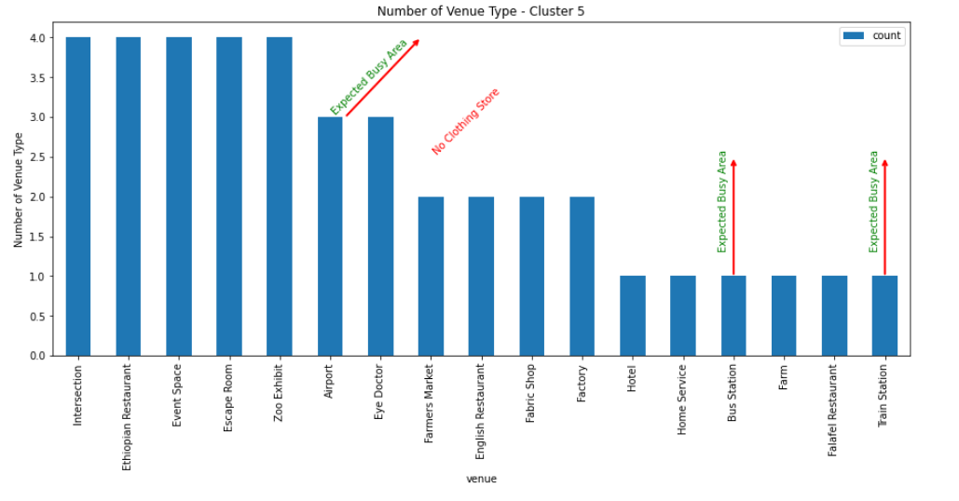
Cluster 5 (containing 0 clothing stores)

Slide 13
Finding Suitable Cluster For Business
Basis for selection: Availability of clothing store
Clusters analysis:
Cluster 1 (containing 4 clothing stores)
Cluster 2 (containing 15 clothing stores)
Cluster 3 (containing 0 clothing stores)
Cluster 4 (containing 0 clothing stores)
Cluster 5 (containing 0 clothing stores)

Slide 14
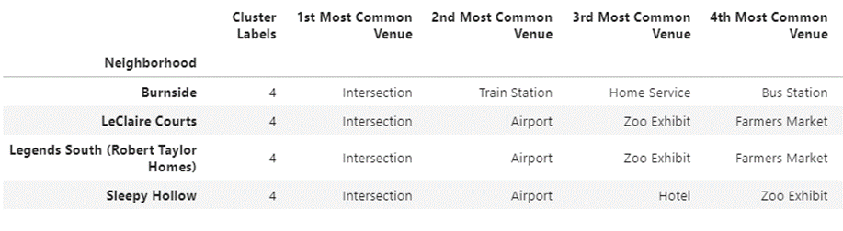
Finding Suitable Cluster For Business
Recommendation: Cluster 5
Selection Basis: Intersection, Bus Station, Train Station & Airport

